Slide 1
Park-Me
Team5: Shriya Vaagdevi Chikati, Cassandra Lundberg,
JT Whetstone, Wenzhuo Zhao

Slide 2
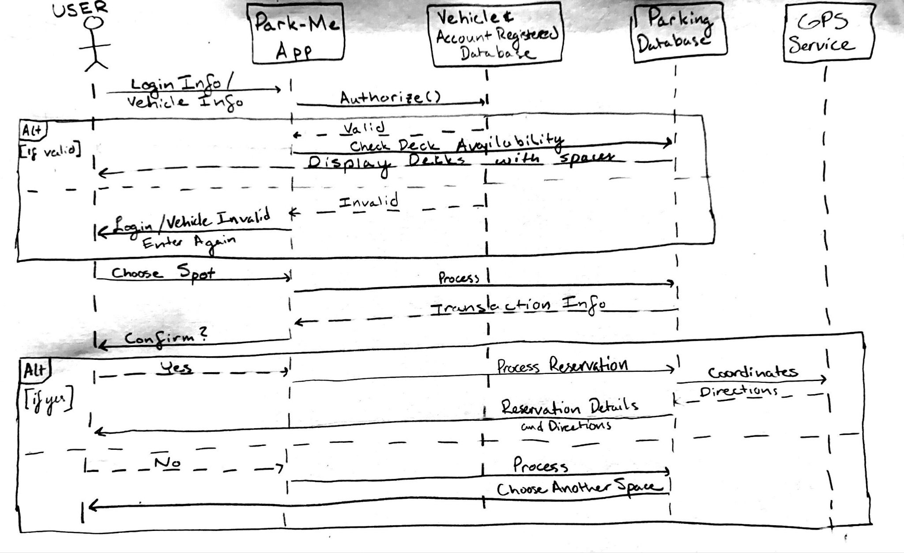
UML Sequence Diagram

Slide 3
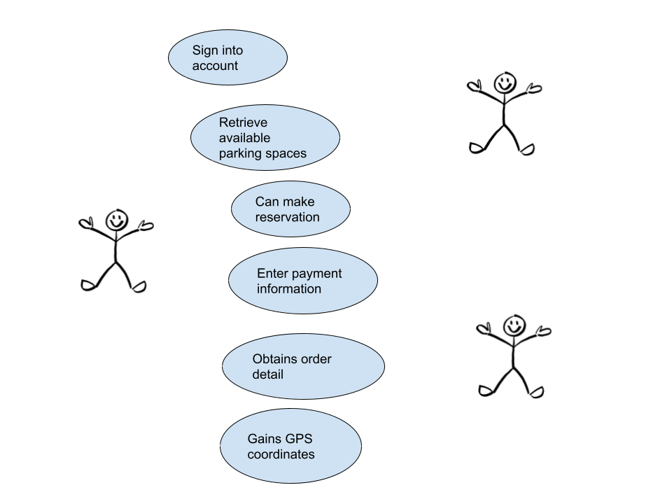
Use Case Diagram 1

Slide 4
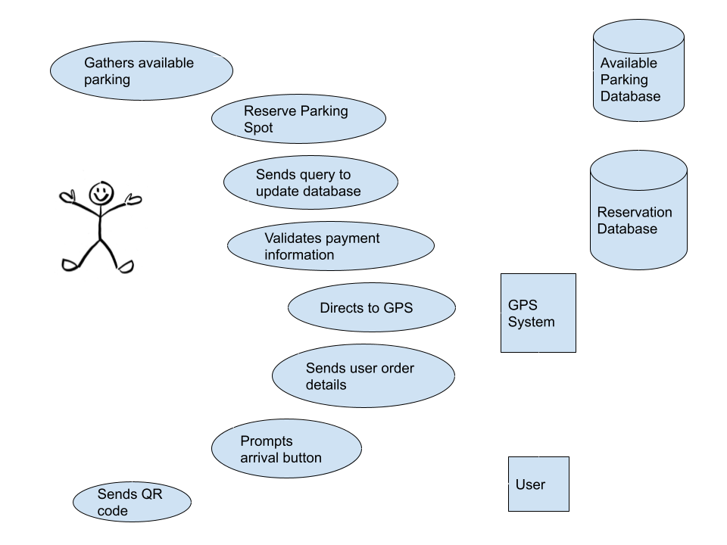
Use Case Diagram 2

Slide 5
Test Scenario 1
Authentication when the user logins into their GSU account
Check that the user's account and password are correct and enter the service
Parkme mobile app displays the list of available parking spots
User selects one parking spot, and generate the order after checking whether the selection is feasible
Validation of payments details
Check the GPS connection of the user's phone, the user gets the parking spots’ GPS.
Verify that the parking is successful.
System updates the available spots database
Update user information and account balance

Slide 6
Test Scenario 2
Authentication when the user logs into their GSU account
ParkMe mobile app displays a list of the available decks when the user selects “Reserve Parking Spot”
Retrieval and display of available parking spots to choose from in the form of graphical view of deck
System updates the available spots database
Validation of payment details
System prompts the user to continue booking and displays booking details
System updates the Reservation database with reservation details
App redirects user to an external site to direct user to deck
System sends QR code to user once they have reached the deck
Validation of QR code
API directs user to reserved parking spot
System prompts user to press “I’m Here” button to affirm destination arrival

Slide 7
.
Thank you!

